Slide 1
Deep Learning: The Future of Real-Time Rendering?
Marco Salvi
NVIDIA

Slide 2
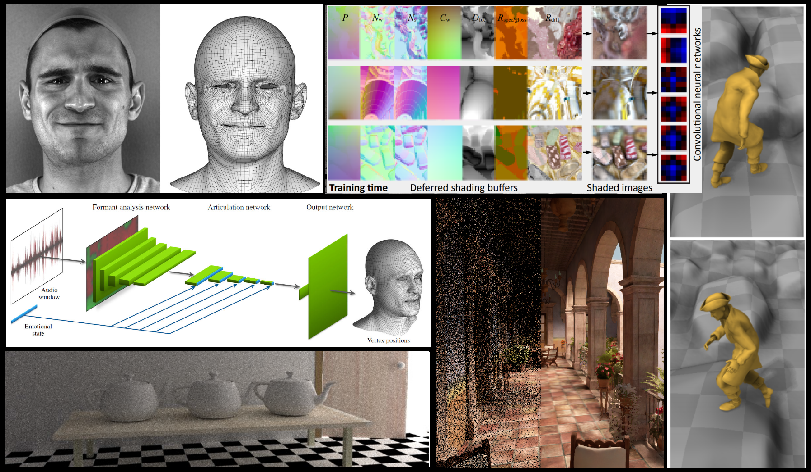
Deep Learning is Changing the Way We Do Graphics
[Laine17]
[Holden17]
[Karras17]
[Chaitanya17]
[Dahm17]
[Nalbach17]
Notes:
Deep learning has already changed the way we, as researchers, do graphics.
This is just a small sample of recent publications that use deep learning to solve a very wide range of graphics-related problems.
From generating natural motion for animated characters [Nalbach17] to denoising images rendered with an interactive Monte Carlo path tracer [Chaitanya17].
From using reinforcement learning to learn complex light transport [Dahm17] to replacing the backend of the real-time rendering pipeline with a deep neural network that can generate the final image from a G-buffer [Holden17]
On the content creation front we are seeing work that can generate high quality facial animation from a single camera video feed that can be used in AAA games [Laine17] or even from just an audio recording of an actor’s performance augmented by metadata on the emotions the performer is trying to express [Karras17].

Slide 3
Video “Audio-Driven Facial Animation by Joint End-to-End Learning of Pose and Emotion” Tero Karras, Timo Aila, Samuli Laine, Antti Herva, and Jaakko Lehtinen
Notes:
Example of how deep learning can be use to solve the incredibly challenging task of mapping an audio recording to a realistic facial animation.
Incredible work like this one inspired me to look into deep learning as a tool for real-time rendering research.
Today’s presentation is split in three sections. I will first provide a gentle introduction to some of the basic ideas underlying DL methods.
I will then show how to use these methods to build a novel solution for a long standing real-time rendering problem: anti-aliasing.
Finally I will conclude the presentation with a few thoughts on open problems and directions for future work.
--------------------------------
“Audio-Driven Facial Animation by Joint End-to-End Learning of Pose and Emotion” research page:
http://research.nvidia.com/publication/2017-07_Audio-Driven-Facial-Animation
Video:
https://youtu.be/lDzrfdpGqw4

Slide 4






What is Deep Learning?
Document icon by Arthur Shlain
Notes:
At its core deep learning is a set of tools we can use to learn a function that transforms some data A into some data B.
At school we were often given a mathematical function and we were asked to apply it to some data to determine its output. This is a task that computers (and some humans) can do very well.
On the other hand computers have historically been quite poor at performing tasks that most people can do effortlessly most of the time, like transcribing the spoken word into text.
In this example we have a dataset A (recorded voicemail) and a dataset B (transcribed voicemail) and we want to learn a function that maps A to B.

Slide 5

What is Deep Learning?
Document icon by Arthur Shlain
Notes:
It’s not hard to manually build such function F, even for the most disparate data.

Slide 6


What is Deep Learning?
Does it generalize?
Document icon by Arthur Shlain
Notes:
The real difficulty lies in discovering a function that can generalize to an arbitrary audio recording (X -> Y)
Generalization is a particularly useful and powerful property and it’s likely that in most cases we will be seeking mappings that generalize to a wide range of data

Slide 7
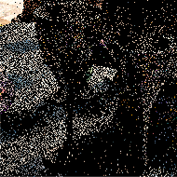
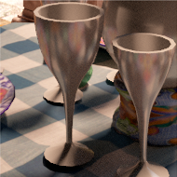
What is Deep Learning?
Notes:
While automating the transcription of audio recordings is an extremely useful application, as people that do graphics, we want to focus on something a bit different.
For instance we might want to find a way to map noisy images rendered with Monte Carlo methods to a noise free image that is also rich in details.
Later in the presentation we’ll see how relatively easy is to attack such image reconstruction problem, and many others, using DL-based methods.

Slide 8



Multilayer Perceptron (simple)
input layer
hidden layer
output layer
Notes:
The first and most simple object we are going to discuss today is the multi-layer perceptron, a feed forward artificial neural network (from left to right, in the diagram).
This vanilla MLP has 1 input and 1 output layer. An hidden layer h computes a linear combination of all the inputs for each neuron, followed by a non-linear transformation g.
The output is generated by another linear combination of all values generated by the hidden layer.
Without the non-linear function g we could simply compose the transformations applied in the hidden linear into the output layer, thus removing the hidden layer entirely.
The role played by g is to dramatically increase the representational power of MLPs.
It has been shown that a simple MLP with linear output and with an arbitrarily wide single hidden layer can represent a large class of functions and their derivatives as well.
Although it’s not a given we will be able to learn the function we are looking for: i.e. learn “best” the W and b parameters for a given task.

Slide 9
Multilayer Perceptron (deep)
Notes:
We’ll see in a minute while using very wide hidden layers is not necessarily a good idea.
Fortunately the representational power of a multi-layer perceptron can be increased by adding more (possibly narrower) hidden layers to build a deep(er) artificial neural network.
The term “deep” is used when working with networks that have more than one hidden layer.

Slide 10


Learning via Loss Minimization
Loss function measure distance between true and predicted output
e.g.
Gradient of the loss function provides deltas to update network weights (gradient descent)
The artificial neural network is just a (mostly ☺) differentiable function!
DL frameworks exploit chain rule to efficiently generate gradients with the backpropagation method
Training the network (when everything goes according plans..)
Evaluate loss
Update weights
Repeat until loss plateaus → profit
Notes:
This is a vastly simplified summary of how we train neural networks to learn the desired mapping from input to output data.
The most important detail to remember is that modern deep learning frameworks use techniques based on gradient descent to minimize the loss function L by learning optimal weights.
These frameworks (TensorFlow, Theano, Torch, etc..) provide relatively easy ways to write differentiable functions whose gradient can be computed in an automated fashion.
As a matter of fact I prefer to see neural networks as a class of differentiable programs.
Thinking about neural networks as directed graphs can be rather useful but also limiting at times.

Slide 11

Learning a (useless) Graphics Pipeline
light direction
image
Notes:
To get a more intuitive understanding of their representational power we can train a single hidden layer MLP to map a light direction (3 floats) to an entire image.

Slide 12
Learning a (Useless) Graphics Pipeline
3 (light dir)
16
tanh
128 x 128 x 4 (RGBA)
linear
Notes:
The input to the network is the light direction and the output is the final image (128 x 128 pixel x 4 color channels)
As hidden layer we make an arbitrary choice of 16 neurons with tanh as non-linear activation function g()

Slide 13
Live Training Demo
Notes:
After live training the network with~500 images rendered with random right directions the network has learned the image we are rendering with the GPU.
By changing in real-time the light direction we can see how the inferenced image capture in first approximation the lighting as we compare it to the reference solution rendered with the classic 3D graphics pipeline.
This is actually a case of so-called overfitting where we have somewhat compressed the re-lightable image in the network weights.

Slide 14
Convolutional Layers
Fully connected layers are a powerful tool but..
Don’t scale well (curse of dimensionality)
Number of elements to process is wired in the network
No notion of locality
Convolutional layers
Limit connectivity to local neighborhood (e.g. 3 x 3 neurons) → locality & improved scaling
Share same weights over the entire layer → resolution independent
Can be thought as performing a convolution with the same weights over the entire image
Can perform downscaling and upscaling
Notes:
Downscaling is typically done with so-called pooling layers that perform a local reduction (max, average, and so on..).
Another way to downscale data is to apply a convolution with stride greater than 1. Conversely by using a fractional stride smaller than 1 we can upsample data.

Slide 15
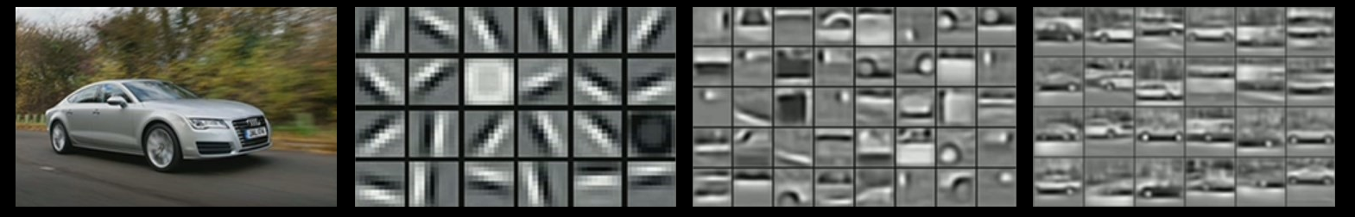
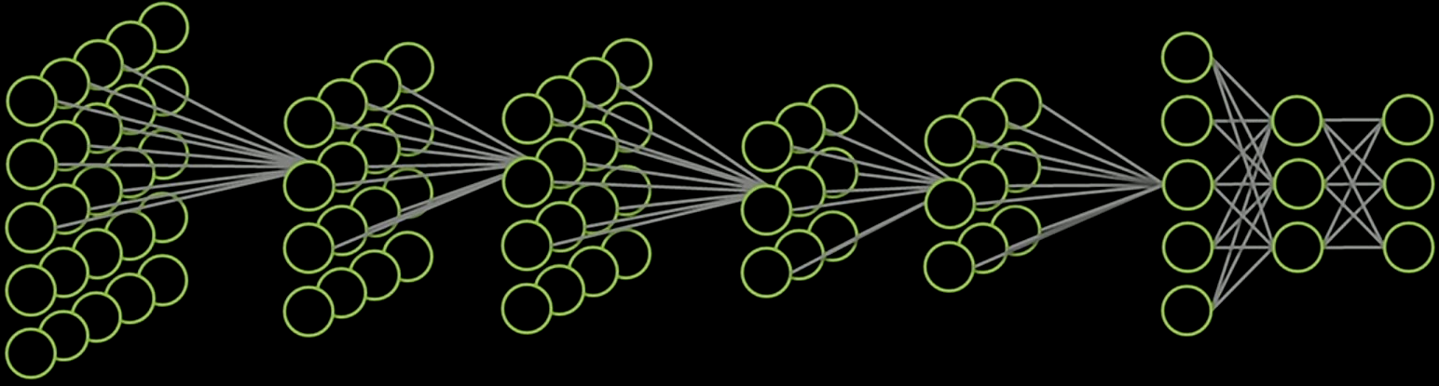
Convolutional Neural Networks
Image source: “Unsupervised Learning of Hierarchical Representations with Convolutional Deep Belief Networks” – ICML 2009 and Comm. ACM 2011
Honglak Lee, Roger Grosse, Rajesh Ranganath and Andrew Y. Ng
Image
“Audi A7”
CNNs extract features at different scales
FCLs generate final answer
Notes:
This work highlights the ability of CNNs to extract features at different scales.
The backend of the network uses fully connected layers to classify vehicles from the high level features extracted by the preceding CNN layers.

Slide 16





Convolutional Autoencoder
Notes:
The encoder stage of the autoencoder (blue layers) induces a new representation of the input data through a series of convolutional and dowsampling layers.
For instance when we process an input image we can progressively generate a smaller but deeper image, until we reach the bottleneck (green layer) that encodes the “latent representation” of the input.
If we train the autoencoder to learn the identify function the decoder stages (red layers) take the latent representation and expands it back to the original image.
While learning the identify function might not seem like a particularly useful thing to do, we note that if the degrees of freedom available in the autoencoder are fewer than those available in the input, then the autoencoder is forced to learn a compressed representation of the input (which is stored in the bottleneck).
For instance we could build an image compressor by using the encoder stage to generate a compressed latent representation and store it in a file. To decompress the image we would load the file and send its data through the decoder stage.

Slide 17
Denoiser
Notes:
We can turn the autoencoder into an image denoising machine by training it to generate the latent representation of a noise-free image from a noisy image.
As a matter of fact we can attempt to train the convolutional autoencoder to perform any sort of image restoration/reconstruction task..

Slide 18
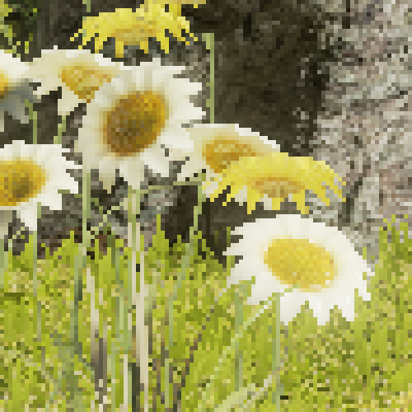

Post-processing Antialiasing
Notes:
..including reconstructing an antialiased image from an aliased one.

Slide 19
Case Study: Antialiasing

Slide 20
Antialiasing Autoencoder
Trained with thousands of 8 frame sequences from three different scenes
Captured sequences of 16 spp (unresolved) images
Reference images by resolving 4x4 tile = 16 spp to 1 pixel
1 spp images by picking random sample in a 4x4 tile → sub-pixel jittering in time
Set LOD bias to +1 when rendering → 1spp image exhibits an effective LOD bias of -1 due to downscaling
Required if we want to approach the image quality of a supersampled image
Training data augmentation
Random 192x192 crops from 1080p images
Random 0, 90, 180 and 270 degree rotation
Randomly play sequence either forward or backward
Used spatiotemporal loss function to promote temporal stability
Notes:
We train the autoencoder with sequences of 8 frames using a loss that include spatial and temporal terms.
The temporal loss cam be computed as L2 norm of the difference between the temporal gradient of the reference solution and the image generated by the network at prediction/inference time.
Miniziming the temporal loss is important in real-time rendering as we want to reduce temporal instabilities due to aliasing and other artifacts as much as possible.

Slide 21
Antialiasing video: 1spp vs. Autoencoder
Notes:
In this video we see how the autoencoder can be effective at antialiasing a stream of 1 spp but ineffective at reducing temporal issues.
While we trained the network to minimize a temporal loss, by operating on a single image at time we are not providing enough information to produce more consistent results from one frame to the next.

Slide 22






Recurrent Neural Networks
If we see our network as a differentiable program..
..an RNN is just a loop
Notes:
RNNs are networks that include a memory, called “hidden state”.
The output of an RNN is stored in its hidden state and it is reused to compute its future output, and so on.
From the POV of a differential program an RNN is just a loop where the output of the current iteration takes part in computing the output of the next iteration.

Slide 23
Curse of the Receptive Field
Small convolutions are ineffective
Large convolutions can be more effective but..
Become rapidly impractical
Don’t scale with image resolution
Movement is relative, conv. size is absolute
RNN state is anchored to the image plane
Need conv. as large as the whole image
If only this problem had been solved before.. ☺
Per-pixel RNN
7x7 receptive field
3x3 receptive field
Notes:
We can train a per-pixel convolutional RNN (i.e. an RNN whose output is computed using a convolutional layer) to process each pixel in the image and accumulate information over time.
Soon we realize that if an image feature moves outside the receptive field of our convolutional layer the RNN cannot possibly “see” how the feature data evolves over time.
One can use large convolutions to reduce this issue, but they are expensive and don’t scale well with image resolution.
The main issue is that the RNN hidden state is anchored to the image plane. Instead it should “follow” the moving features in the image to capture their data over time.

Slide 24




Warped Recurrent Neural Networks
warp RNN hidden state using dense motion vectors
Notes:
We can accomplish this by using a popular idea in real-time rendering: back-projection.
In practice we take the hidden state of the RNN and before processing a new frame worth of data we warp it to align to the new frame features.

Slide 25
Warped Recurrent Neural Networks
RNN hidden state is now anchored to moving triangle
Notes:
Despite the small receptive field the RNN is now able to follow the moving triangle since we anchored its hidden state to it.

Slide 26

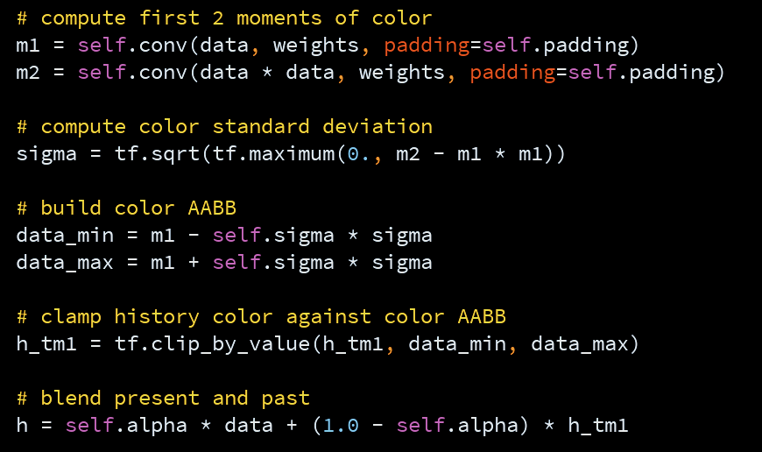

TAA in TensorFlow
box filters
Learn CNN weights to compute improved color AABB
Notes:
Working on the warped RNNs made me realize we can map a well known AA algorithm like modern TAA to a single warped convolutional RNN layer.
After re-implementing TAA in TensorFlow I decided to tune it by learning the convolutions used to compute the first and second raw color moments (using the same data and training procedure used for the autoencoder)
Notice that the original convolutions are just three identical 3x3 box filters, one per color channel.
The learned convolutions are three different 3x3x3 convolutions. The extra dimension allows us to also incorporate/learn dependencies between color channels.
---------------------------
The TAA implementation is mostly based on Brian Karis and Timothy Lottes’ work in UE4, with modifications in the way the color AABB used to remove ghosting is computed and how the motion vectors are filtered. Details can be found here:
http://developer.download.nvidia.com/gameworks/events/GDC2016/msalvi_temporal_supersampling.pdf
and here:
http://www.gdcvault.com/play/1023521/From-the-Lab-Bench-Real

Slide 27
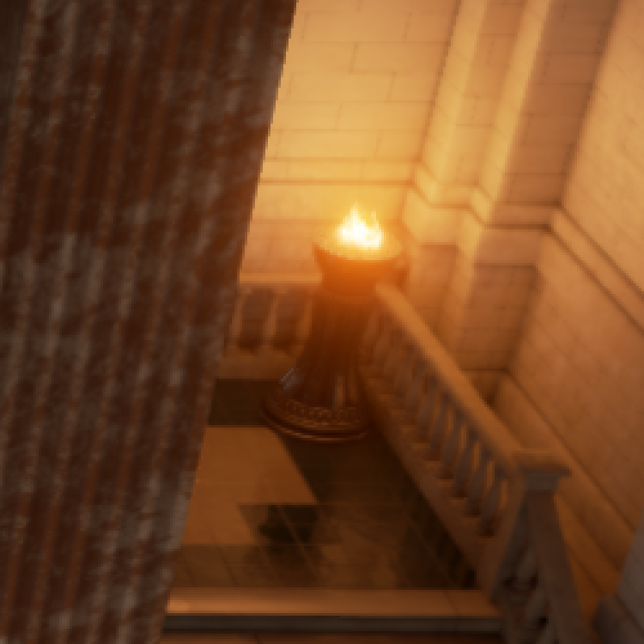

TAA
Notes:
We now compare the classic TAA against the new “learned TAA”..

Slide 28


Learned TAA
Notes:
..as you can see the learned TAA generates a sharper image

Slide 29
Learned TAA
Generally sharper image than “regular” TAA
Temporal stability seems to be unaffected (still very good)
Cost should be similar to TAA
Slightly more expensive math to compute the color moments

Slide 30
Warped Recurrent Autoencoder
Warped Convolutional RNN
Notes:
We modify the autoencoder by changing the first encoder layer into a warped convolutional RNN layer.
This modification enables the autoencoder to finally learn dependencies between data in space and time.

Slide 31
TAA

Slide 32
Learned TAA

Slide 33
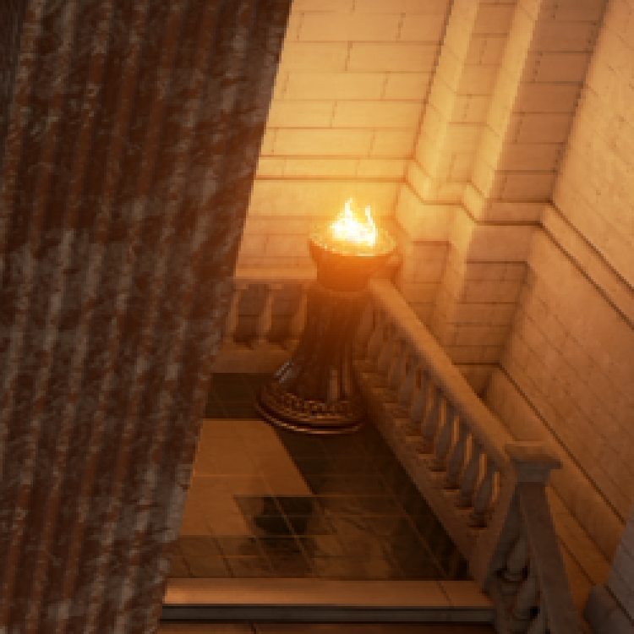

Warped Recurrent Autoencoder
Notes:
The warped recurrent autoencoder generates images that are much sharper than TAA and learned TAA and also less biased/much closer to the reference solution rendered at 16 spp

Slide 34
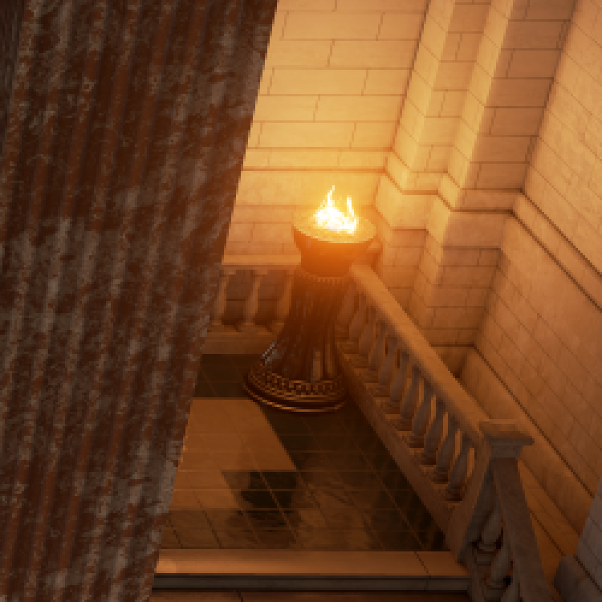

Reference (16 spp)

Slide 35
Antialiasing video: AE vs. Warped RAE
Notes:
The video shows how WRAE generates higher quality and much more temporally stable antialiased images than a simple autoencoder.

Slide 36
Antialiasing with Warped Recurrent Autoencoder
WRAE learned how to temporally integrate color while also removing stale data from the past
This capabilities are hardwired in learned TAA
Generates more detailed and less biased images than learned TAA
Still very temporally stable
Less ghosting than TAA with noisy/high frequency content
But strangely we observe more ghosting in simpler situations well handled by TAA
Notes:
WRAE learns how to integrate color samples over time while removing the stale ones. The TAA network instead is hardwired to perform such operations.

Slide 37
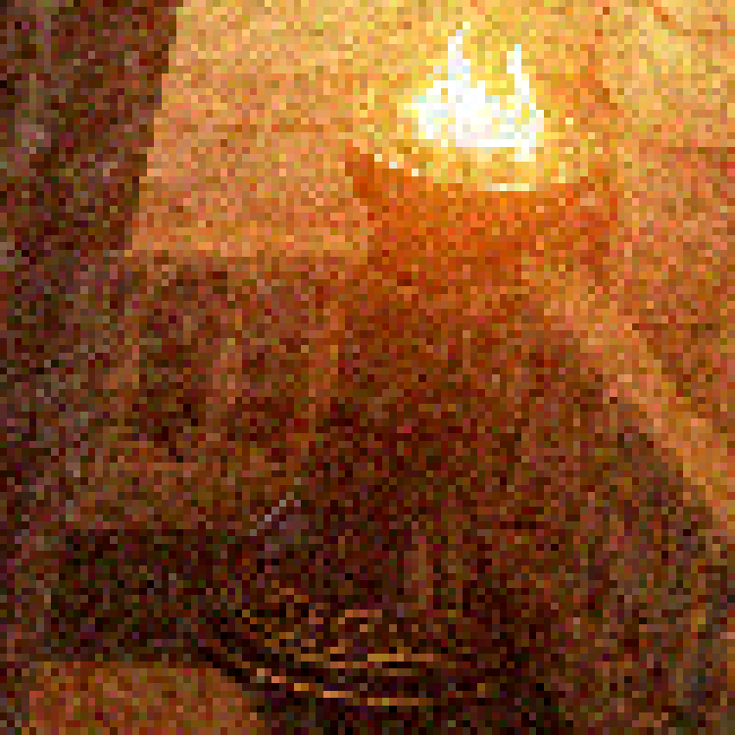
Antialiasing and Denoising
Warped Convolutional RNN
Notes:
As mentioned before we can use an autoencoder to try to fix any sort of image defects.
To prove this point we add 30% Gaussian noise to the aliased 1 spp images (the noise changes in time) and we train the WRAE to reconstruct an anti-aliased and denoised image, all at once, without making changes to the WRAE architecture.

Slide 38
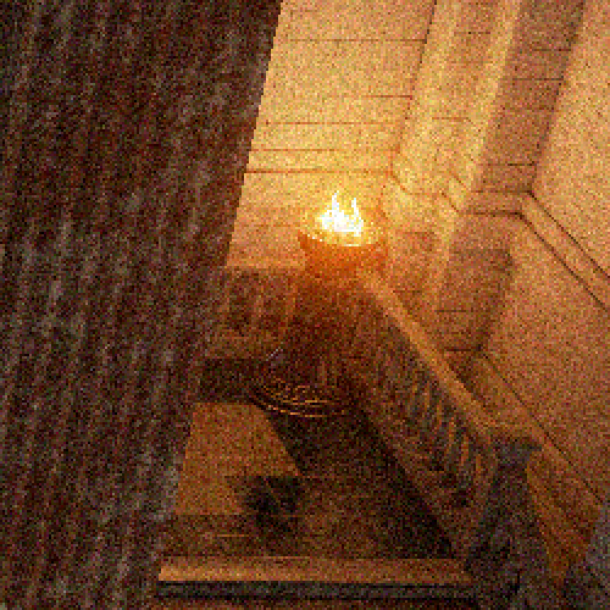
1 spp + 30% Gaussian Noise

Slide 39
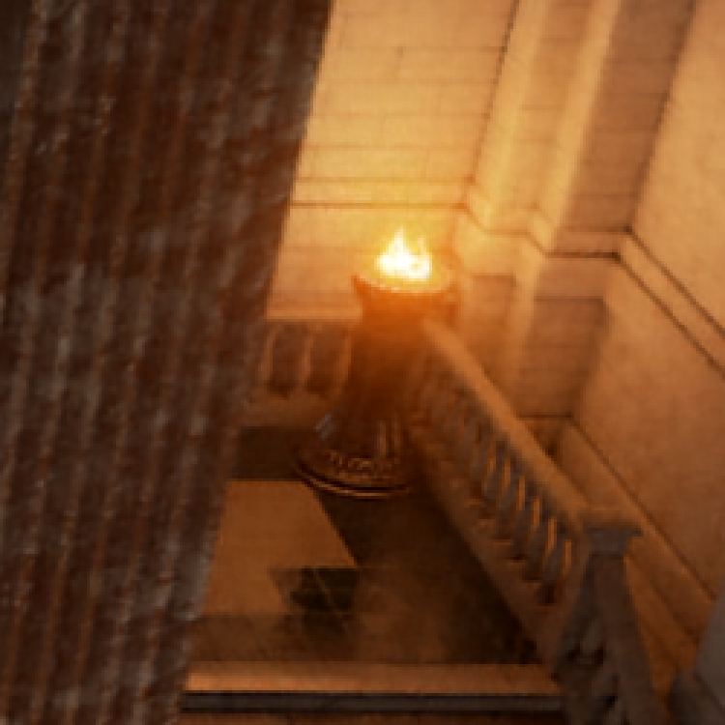

Denoised with Warped Recurrent Autoencoder
Notes:
It is easy to see the WRAE is very effective in removing the noise from the original image while reconstructing some of the missing details and applying antialiasing.

Slide 40
Denoising Video
Notes:
The video shows how remarkable the denoised and antialiased results from WRAE are.
Much of the stochastic noise is gone and the result is very temporally stable.

Slide 41
Open Problems & Directions

Slide 42
Programming Model and other Grievances
A network is just a differentiable program..
..but deep learning frameworks are designed to build graphs performing operations on tensors
At times can feel like writing parallel code using intrinsics for a 1M-wide SIMD processor
Doesn’t work well when all you want to do is writing some SIMT code
An RNN should just be a loop in the differentiable program, not a special graph node/black box
…
Debugging can be hard
Graph is built and compiled at run time, but most errors are only caught at graph execution time
Error messages can be quite cryptic
Lack of support for operations we take for granted in real-time gfx APIs (e.g. texture sampling)
Notes:
Deep learning frameworks have not been designed with (real-time) graphics in mind.
No libraries for gfx operations (e.g. It’s not fun to implement texture filtering in Tensorflow)
Also casting everything to graphs might be limiting our view of what is possible to achieve with deep learning.
All we need is the ability of writing differentiable programs (almost) like we write every day’s code
Debugging is hard in TensorFlow.

Slide 43
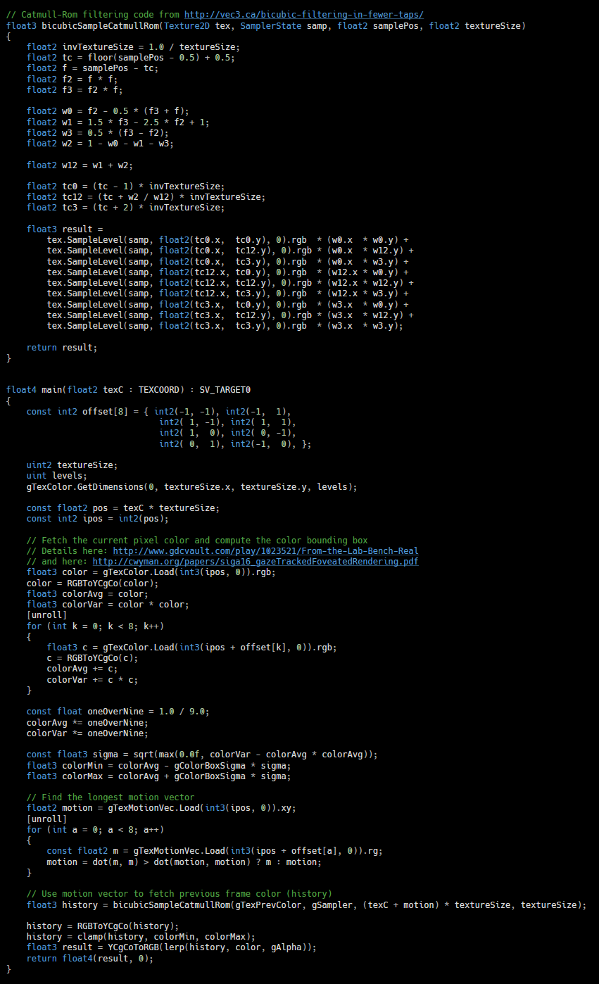
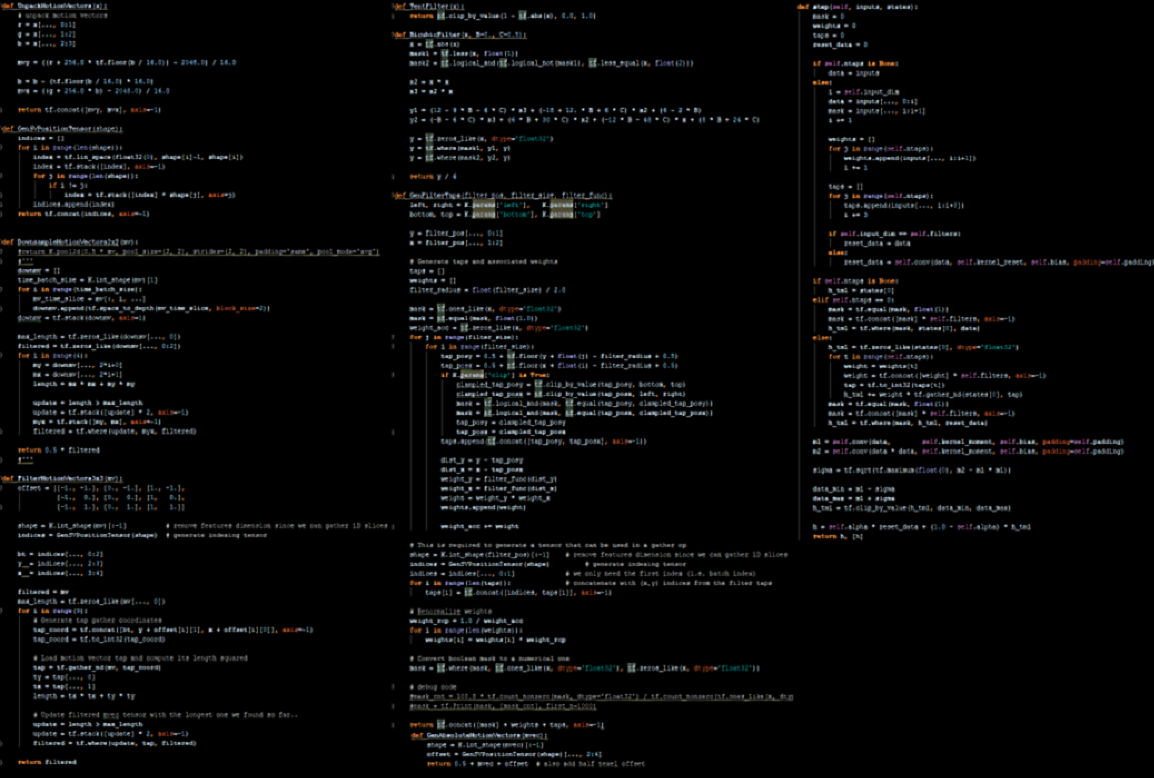
Implementing TAA was tedious and error prone
TAA in HLSL
TAA in Tensorflow
Notes:
Exercise left for the readers: train network to generate the code for the TensorFlow-based TAA implementation from the scaled down screenshots

Slide 44
Temporal Stability Is Hard
Warped RNNs are a step forward, but many limitations
Not always possible to have accurate motion vectors
e.g. transparent layers, dynamic shadows, reflections, refractions, animated UVs, etc.
Many other possibilities to explore
Dilated convolutions to reduce the cost of large receptive fields
3D Convolutions (space + time)
Attention models
…

Slide 45
Autoenconders
Real-time Image reconstruction / restoration
Fix artifacts caused by approximations and shortcuts
Caution: must be able to generate reference image
Antialiasing
Upsampling / super-resolution
Foveation
…
Denoising
Soft shadows
Motion & defocus blur
Interactive path tracing
Notes:
Autoencoders are really fantastic machines that can fix an image for you from all sort of defects if trained accordingly.
A possible future scenario is to speed up rendering by taking lots of shortcuts, while retaining the ability of generating high quality images for reference.
Then we can use these images to train an autoencoder to fix the artifacts we generated by not doing “the right thing”.

Slide 46
Countless Opportunities..
Models
Automated appearance-preserving LODs
Blended animations that look natural
New geometry representations?
Move full post-processing pipeline to DL
Co-optimize post-processing pipeline and rendering?
Shading
Faster / higher quality / pre-filtered materials
Learning more optimal G-buffer terms/format

Slide 47
Conclusion
Deep learning is a new powerful and rapidly evolving tool at our disposal
Unlike in other fields, we can generate our training data
Consider deep learning when you don’t know how to otherwise solve a problem
Or to enhance a well known solution
Likely a profound impact on real-time rendering in coming years
Reducing content creation costs, improving performance & image quality
Will deep learning take over significant parts of the graphics pipeline?
Notes:
Excited about future applications we are not even imagining yet!

Slide 48
Acknowledgments
Timo Aila
Nir Benty
Donald Brittain
Chakravarty R. Alla Chaitanya
Andrew Edelstein
Marco Foco
Jon Hasselgren
Anton Kaplanyan
Jan Kautz
Aaron Lefohn
David Luebke
Jacob Munkberg
Anjul Patney
Natalya Tatarchuk
Chris Wyman

Slide 49
Bibliography
[Chaitanya17] “Interactive Reconstruction of Monte Carlo Image Sequences using a Recurrent Denoising Autoencoder”
[Dahm17] “Learning Light Transport the Reinforced Way”
[Karras17] “Audio-Driven Facial Animation by Joint End-to-End Learning of Pose and Emotion”
[Laine17] “Production-Level Facial Performance Capture Using Deep Convolutional Neural Networks”
[Nalbach17] “Deep Shading: Convolutional Neural Networks for Screen-Space Shading”
[Holden17] “Phase-Functioned Neural Networks for Character Control”

Slide 50
Thank You

Slide 51
Backup Material

Slide 52


1 spp

Slide 53
